Slide 1
Azure DevOps Features
Azure DevOps provides the ability for end-to-end management of the product development lifecycle, it comprises the below services.
Azure Boards – is a set of Agile tools that supports planning and complete tracking of the project development progress, defects raised, as well as other issues, i.e., complete project management can be done using Azure Boards. At the backend it has a native support for Scrum and Kanban for Agile. It provides dashboards with integrated reporting that are customizable and have the ability to scale as per business demands.
Azure Pipelines – being a DevOps tool, it definitely provides the Continuous Integration and Continuous Delivery (CI/CD), also known as CICD pipelines to support the build and release of the application from development to production. We will see this in action in the demo in the following sections.

Slide 2
> Azure Repos – is a set of version control tools that can be used to manage codes and their different versions by the development team. It, therefore, helps in tracking the changes made in the code over the period of time with different versions. When the changes are made to the code, DevOps tool takes the snapshots of the files being checked-in so that these changes can be tracked. These snapshots are saved permanently. Additionally, it helps coordination and collaboration between teams working on the same project. Azure Repos provides two types of version control. They are: Git: Distributed version control
Team Foundation Version Control: Centralized version control
> Azure Artifacts – allows the teams to easily package the dependencies and other artifacts required for the application deployment and its functionality, thus making it easier to publish and consume the application. There can be different kinds of artifacts such as – Build Artifacts, Maven, Npm, Nuget, PyPI, Universal Packages, and Symbols

Slide 3
> Azure Test Plans – are a set of rich and powerful tools to test your application that includes manual/exploratory testing and continuous testing. They are easy to use, and browser-based test management solution providing all the capabilities required for different testing methodologies.

Slide 4
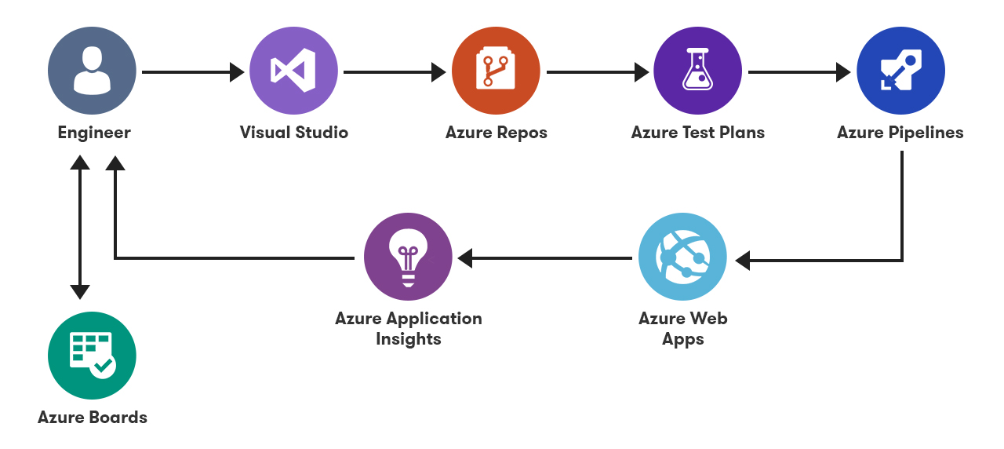
Azure Devops Architecture

Slide 5
Difference between self-hosted and Microsoft hosted
Self hosted agents runs on your in premises servers and MS also provides option to an agent which runs on their VM if you don't have any in prem servers.
Self-hosted can be easily customized to your need and it is simple to run.
So I would prefer self hosted agent as it give unrestricted access to all in prem resource which may be blocked by firewall in case of using MS agent unless we set FW rules.

Slide 6
Create and manage agent pools
An agent pool is a collection of agents. Instead of managing each agent individually, you organize agents into agent pools. When you configure an agent, it is registered with a single pool, and when you create a pipeline, you specify the pool in which the pipeline runs. When you run the pipeline, it runs on an agent from that pool that meets the demands of the pipeline.
In Azure Pipelines, pools are scoped to the entire organization; so you can share the agent machines across projects.
Refer - https://docs.microsoft.com/en-us/azure/devops/pipelines/agents/pools-queues?view=azure-devops&tabs=yaml%2Cbrowser

